Slide 1



Slide 2

Learn Umrah With VR
Supervised by:
Mr. Shezad Rizwan
Group Members:
Ahsan Shafiq Khan (FA17-BCS-034)
Jameel Ahmed (FA17-BCS-012)
Department of Computer Science
COMSATS University Islamabad, Attock Campus

Slide 3
Outline
Introduction
Problem Statement
Proposed Solution
Objectives
Requirement Specification
Methodology
Project Design
Implementation
Modern Tools
Benefits
Future Work
Refrences
_____________________________

Slide 4

Introduction
The Information and computer Technology (ICT) incorporate almost all aspects of life, including education and all other learning process.
The current method of learning about Hajj and Umrah rituals are from different academies, youtube, text books and from different virtual apps which shows only the steps that poses difficulties for users in learning.
To address such problems, this project proposes the use of virtual reality(VR) to aid in learning about all the rituals.
This type of learning can help Users use both text media and 3D models, thus helping them gain a better understanding in learning Umrah process.
_______________________________

Slide 5
Problem statement
Although there are some applications displaying the descriptions about the sacred places of Kaba but there is no proper application which provide learners proper 3D view to learn umrah.
Mostly the old people face troubles while going to academies for learning Umrah process and face difficulties to get reaching in academies.
Time consuming ,need a lot of time to go and attend the classes.
Inability to keep attention during the classes.
_______________________________

Slide 6
Proposed Solution
In this system we are providing a single platform which allows learners to understand complete steps of umrah using virtual reality.

Slide 7
Objectives and Goals
Goals and objectives for this app are:
To teach all the steps of Umrah.
To perform the Umrah in a right manner.
To teach kalima’s that will be recited during the performing Umrah in haram sharif.
To remove the difficulties of aged people they face to reach tuition centers to attend the classes and learn the Umrah steps.
_______________________________

Slide 8
Requirements Specifications
To build this application, one must have system with following specifications
At least 6th-7th genration
At least core i5
Atleast 8GB RAM

Slide 9
Functional Requirements
Learning/Performing Umrah:
FR-01 Ihram
FR-02 Tawaf
FR-03 Sahi
FR-04 Balding

Slide 10
Continue…
FR-05 sacred places information
FR-06 kalimas
FR-07 Virtual tour
FR-08 VR controls

Slide 11
Non-Functional Requirements
NFR-01 Quality graphics
NFR-02 Performance
NFR-03 Reliability
NFR-04 Usability

Slide 12
Methodology
In this system we'll use incremental method which allows us to modify or add-up modules or functionalities as per demand/requirement.
Incremental phases:
Requirement gathering
Design
Implementation
Integration

Slide 13
Project Design
Project design is an important part for developing a graphical view of requirement based on the detailed functional and non-functional requirements.
Project design is only acceptable and marked as good after understanding the requirements of the project provided for development.
It is always good practice to start from making a high-level design and then move it to low-level design phases.

Slide 14
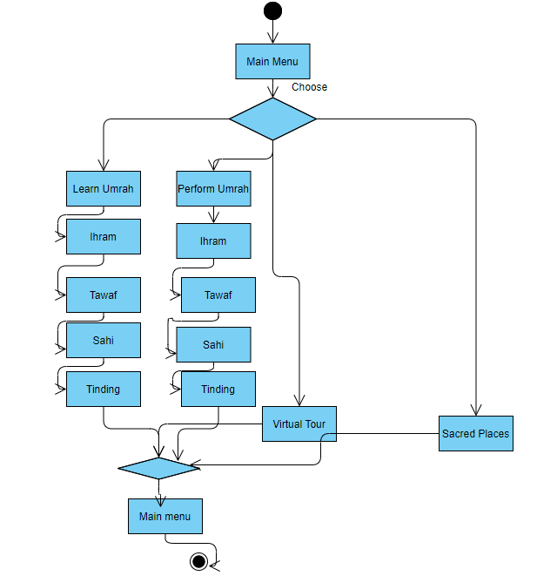
Activity diagram of main menu

Slide 15
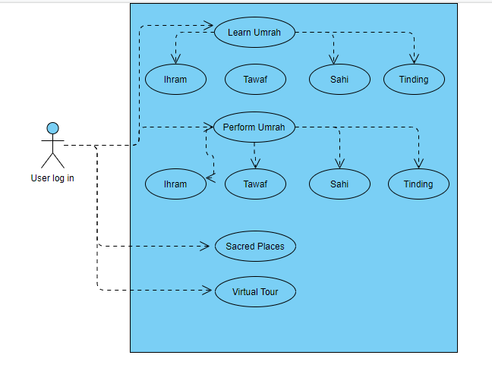
Use case diagram of main menu

Slide 16
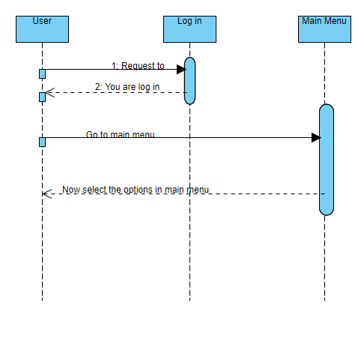
Sequence diagram of account creation

Slide 17
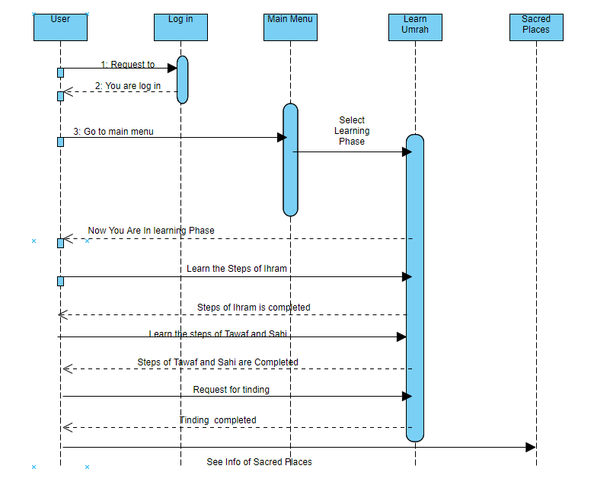
Sequence diagram of main menu

Slide 18
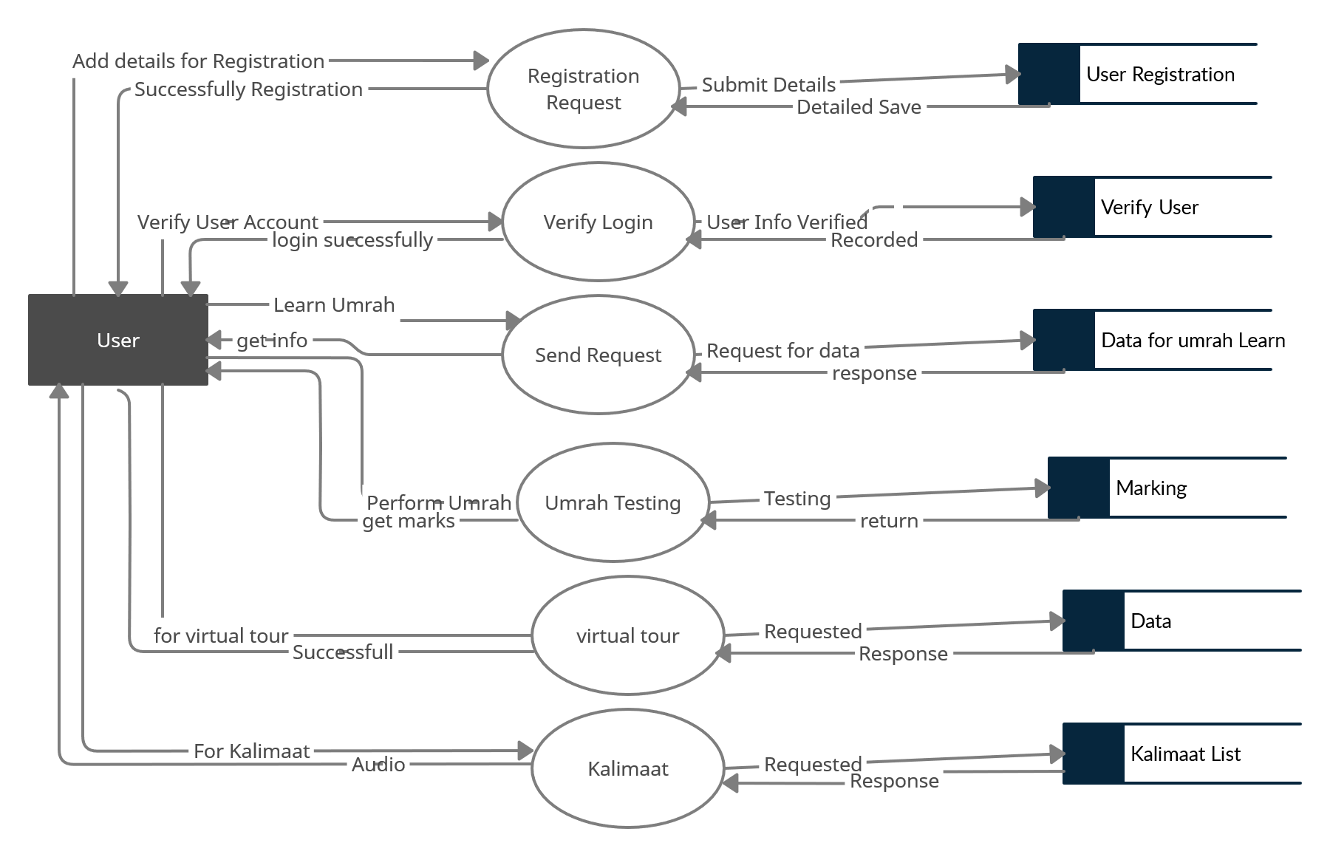
Data Flow Diagram

Slide 19
Implementation
Modern tools and technologies:
Unity 3D Engine
Visual Studio
Blender
Photoshop
Illustrators(UIUX)
Virtual reality
_______________________________

Slide 20
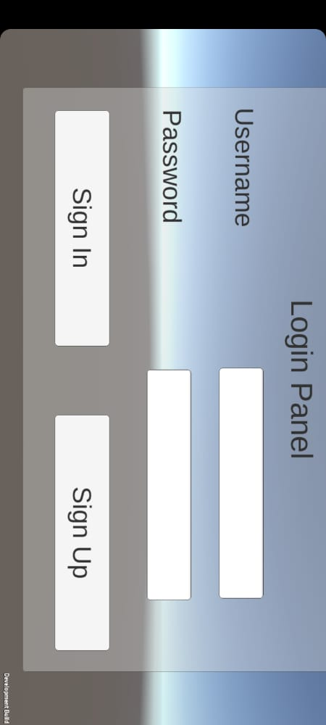
Login Panel

Slide 21
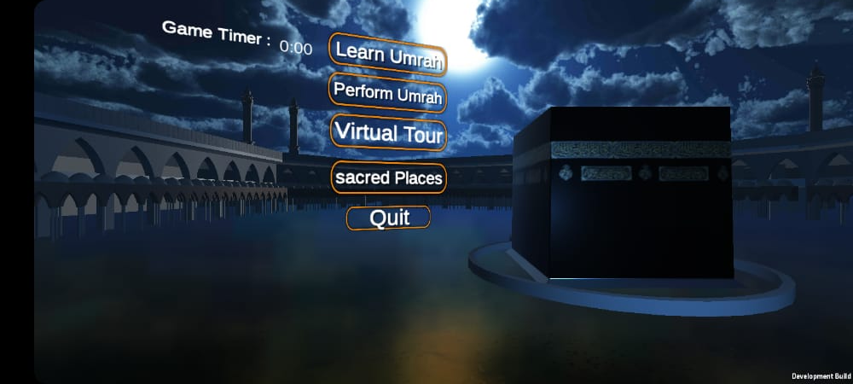
Main Menu

Slide 22
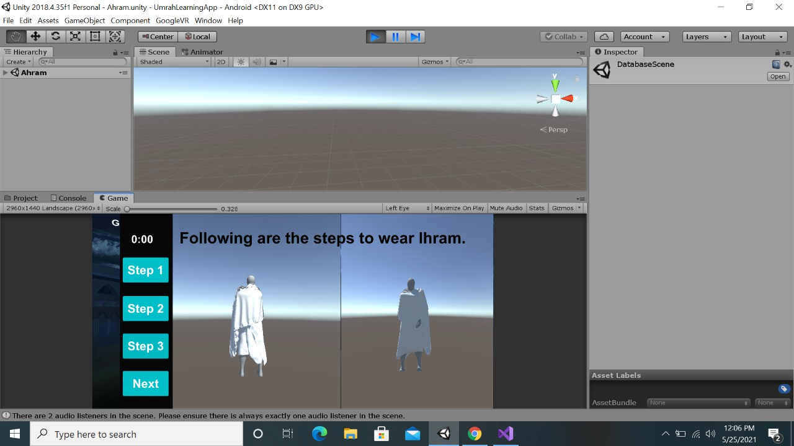
Wearing Ihram in Learning

Slide 23
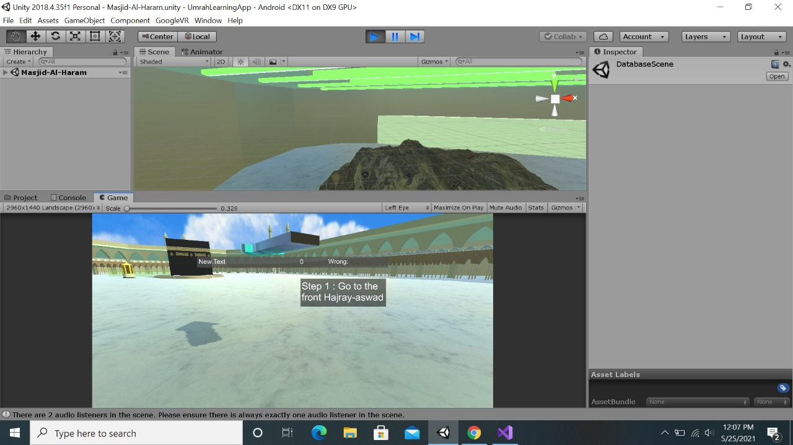
Direction to Hajr-e-Aswad

Slide 24
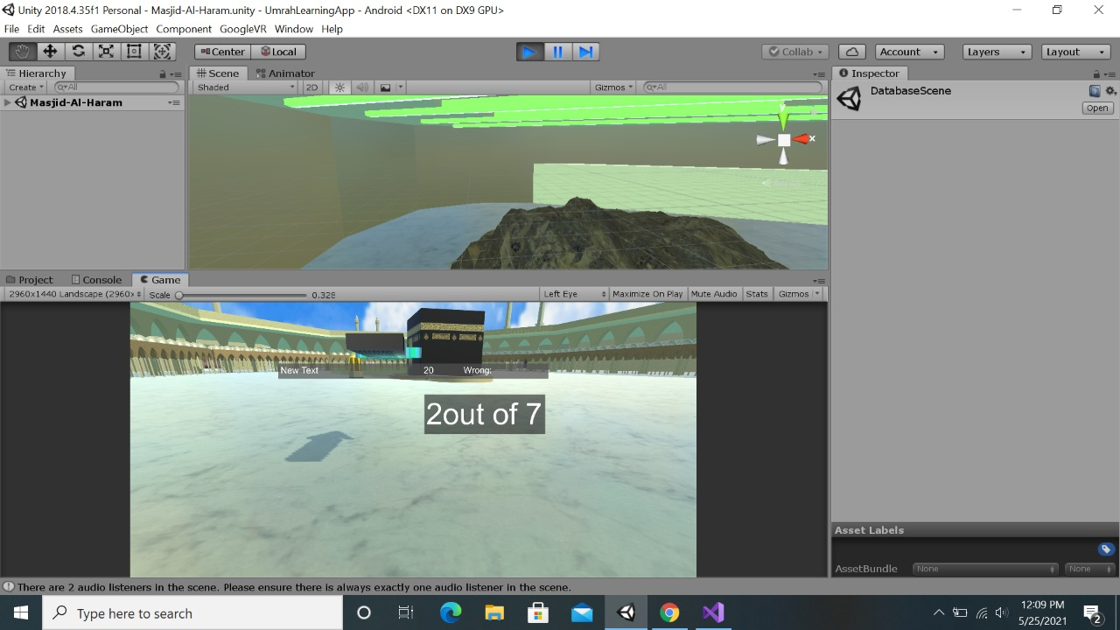
Number of Rounds in Tawaf

Slide 25
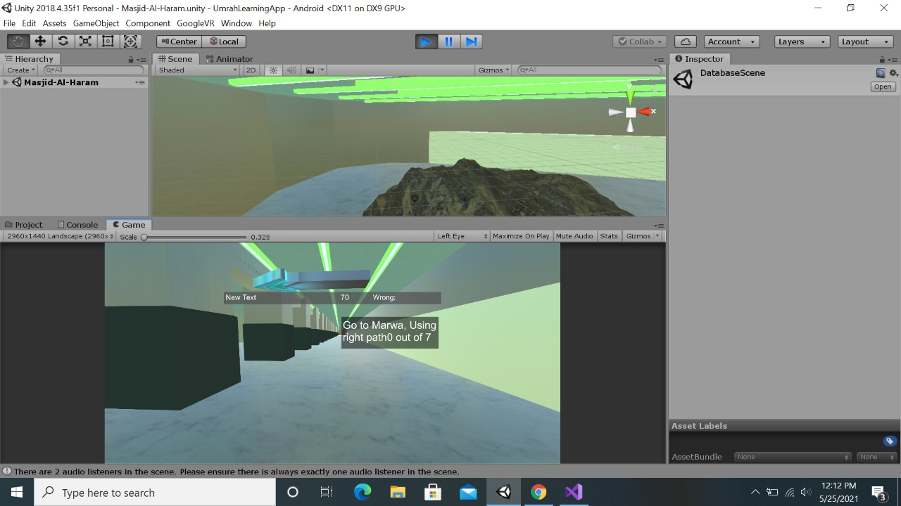
Showing Direction in Sahi

Slide 26
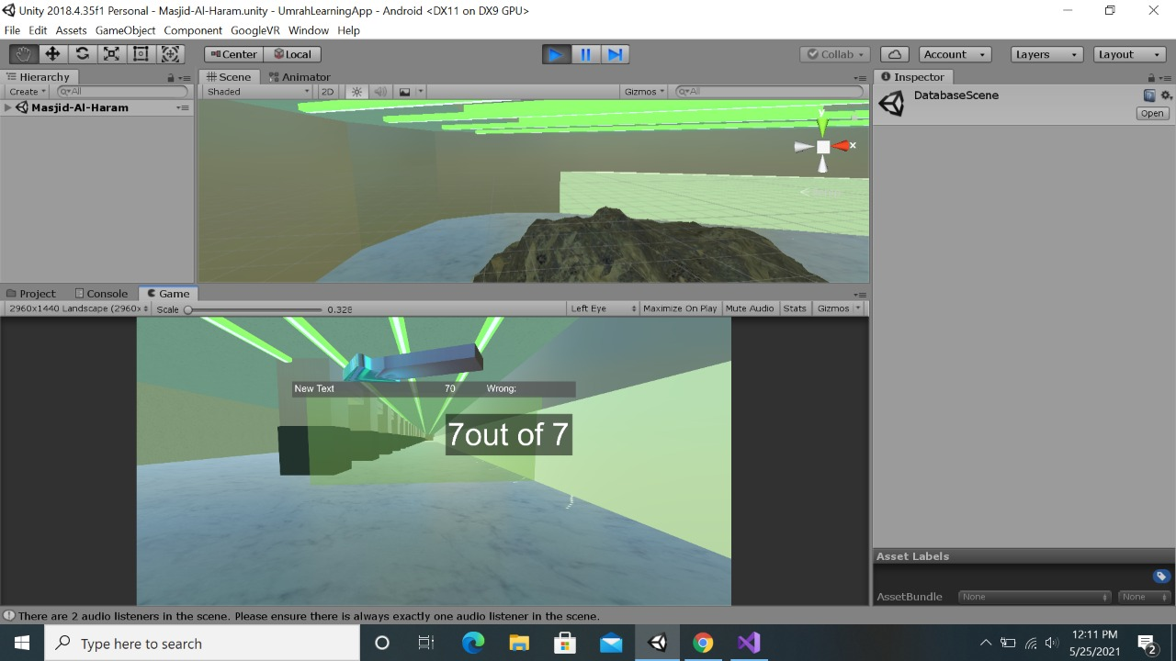
Rounds in Sahi

Slide 27
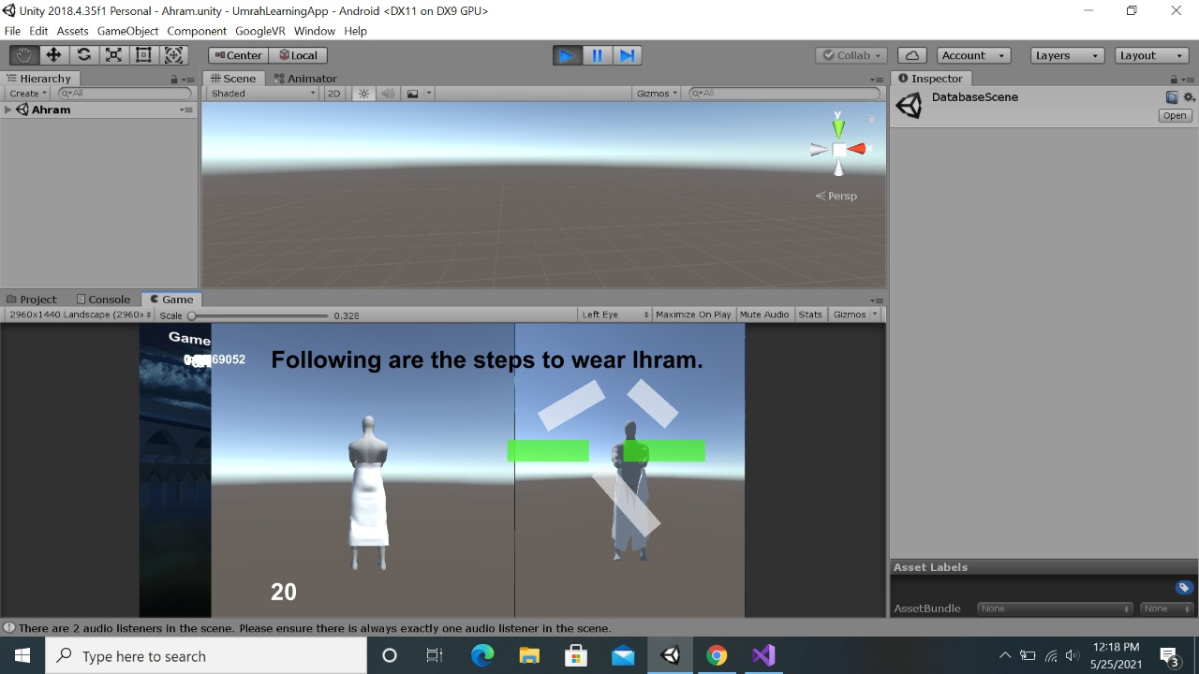
Wearing Ihram in performing

Slide 28
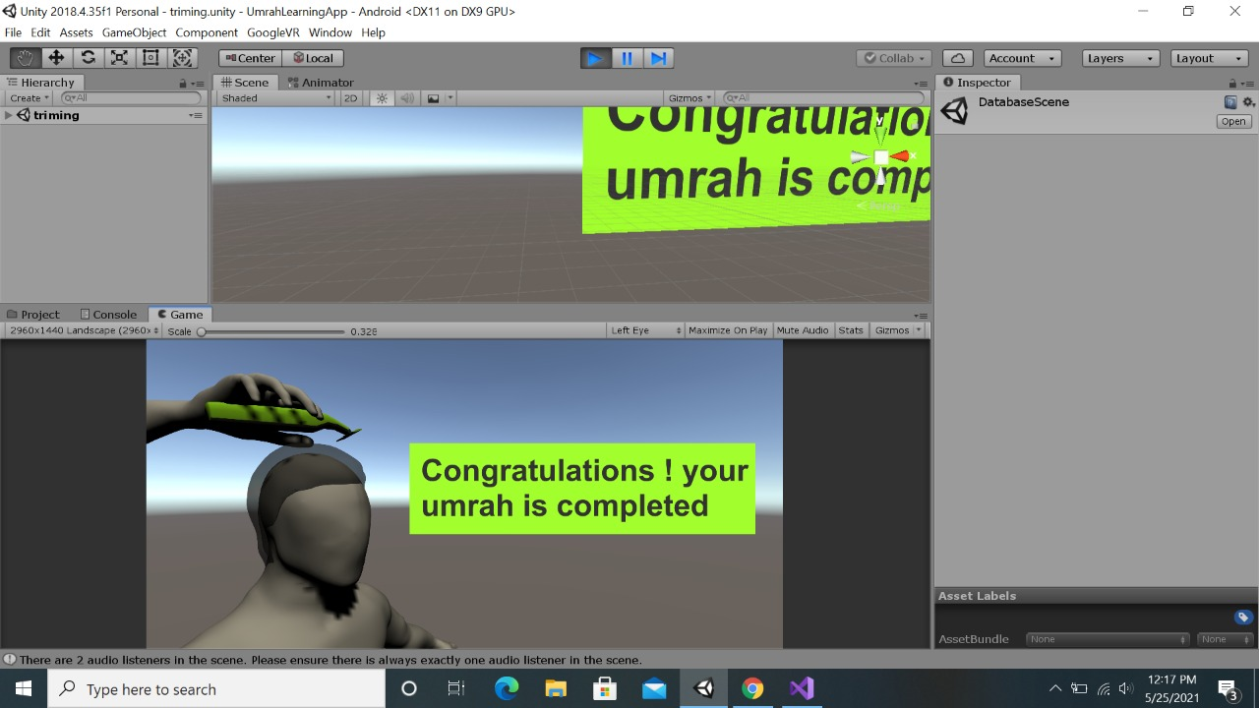
Balding

Slide 29
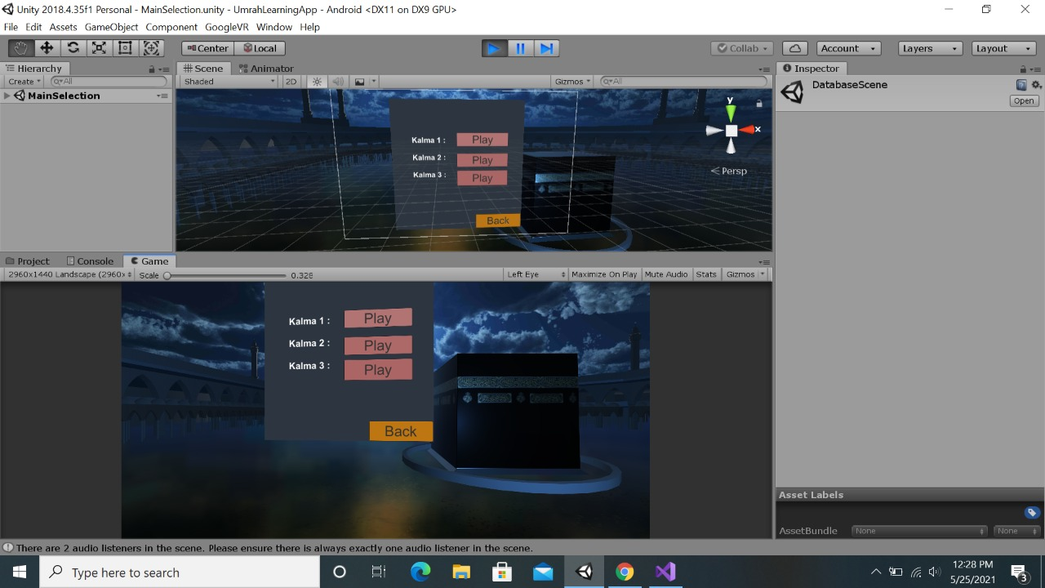
Kalimas

Slide 30
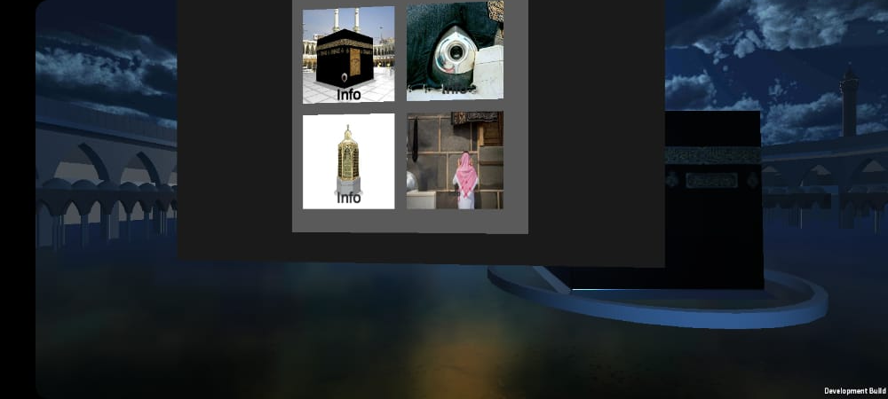
Sacred Places Info

Slide 31
Benefits
People will learn the method of Umrah as if they are actually doing it.
It will be easy for the people to learn all the steps of Umrah without going to tuition center and attend the classes.
The main purpose is less time-consumption for people to learn and this issue resolve by this system as it performs Analytic process quickly.
_______________________________

Slide 32
Future work
Import into IOS:
We created this app just for the android devices. In future , this app can also be implemented in IOS devices because there are many people who are using IOS devices in today’s era.
Extension to Hajj:
As we created the virtual umrah app and we designed the model of “Haram Sharif” and “Safa o Marwa”. This app can be extended to virtual Hajj which will required more models like “Masjid e Nabwi (SAW)”.

Slide 33
References
1.A. Zeki, H. Alsafi, R. Nassr and T. Mantoro, "A mobile dictionary for pilgrims", International Conference on Information Technology and e-Services, 2012.
2.M. Osman and A. Shaout, "Overview of Mobile Help For Performing Hajj Rituals", International Journal of Emerging Technology and Advanced Engineering, vol. 5, no. 11, pp. 14-19, 2015.
3.H. Mohamed, M. Arshad, N. Abdul Rashid, Z. Zainol, W. Husain, O. Abd Majid, et al., "M-Umrah: An Android-based Application to Help Pilgrims in Performing Umrah", 2013 International Conference on Advanced Computer Science Applications and Technologies, 2013.
4.A. Fathnan, C. Wibowo, N. Hidayat, D. Marenda and R. Ferdiana, "Web-based Hajj simulation software Learning Hajj through interactive software", Proceeding of the 3rd International Conference on Information and Communication Technology for the Moslem World (ICT4M), 2010.
5.M. Yusoff, A. Zulkifli and N. Mohamed, "Virtual Hajj (V-Hajj) - Adaptation of Persuasive Design in Virtual Environment (VE) and Multimedia Integrated Approach Learning Courseware Methodology", IEEE Conference on Open Systems, 2011.
_______________________________

